Slide 1

Guided Reading Books
2026-2027
This document shows the core fiction and some non-fiction reading books that children will read throughout the year. They have been chosen to ensure that in their time at All Saints, children have access to a range of authors, illustrators, genres, styles and themes. Some texts have links to units of work such as The Ancient Maya; others have been chosen due the quality of writing, reading age of the children and their interests.
In Early Years and Key Stage 1, we read pictures books daily in addition to our Guided Reading lessons.

Slide 2


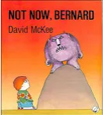











EYFS

Slide 3
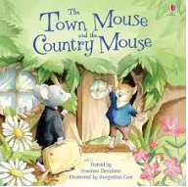





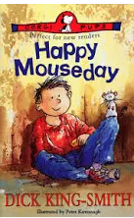


Year 1 and 2

Slide 4
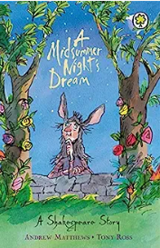


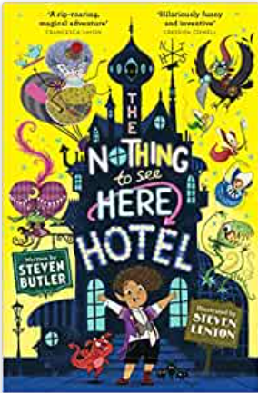


Year 3 and 4

Slide 5

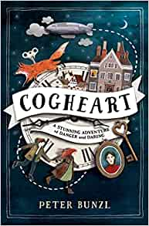


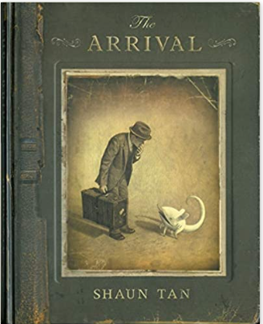
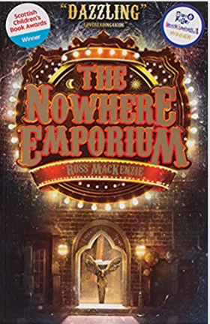


Year 5 and 6

